Slide 1
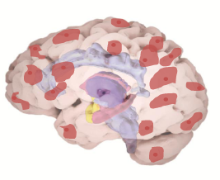
Contiguous Bi-clustering (ConBic) on fMRI data- tests and evaluations
Joint work with Didi Amar
2012

Slide 2
The resting state
In recent years it has become clear that during rest there is ongoing spontaneous changes in brain activity (EEG, fMRI)
Resting state activity is a compulsive user of brain energy
Work in the last decade has revealed slow correlated activity within functional networks in the resting state (i.e. RSNs)
Biswal 95\2008,, Raichle 2001, Greicius and Menon 2003, Beckmann 2005, Fox 2007, Vincent 2007, Martuzzi 2010, Buckner 2008
Notes:
לדבר על כך שיש חיווט פונק' שרואים אותו גם ברסט בלי קשר לתפקוד
דוגמה – רשת סלולרית (אולי תמונה של רשת סלולרית)
רשת הדיפולט – לציין ולהגיד שפועלת בעודף בזמן מנוחה – קשורה לתפישת עצמי, חשיבה ספונטנית

Slide 3
Characterizing RSNs
Altered RS functional connectivity (FC) as been shown to be associated with a variety of cognitive impairments as well as psychiatric disorders Menon 2011, Rabinak et. Al. 2011, Kim et. Al. 2011, Assaf et. Al. 2010, Hawellek et. Al. 2011
Altered FC has also been shown to be associated with self reported anxiety levels in healthy subjects Seely et. Al. 2007, Kim et. Al 2011
FC patterns characterization
Hypothesis driven (seed based)
Data driven approach (e.g. ICA, PCA, Clustering, graph measures) – signal to noise issues, interpretation difficulties
Notes:
Rabinak - PTSD-Amygdala connectivity
Kim et. Al. – Anxiety-Amygdala connectivity+normal emotions
Assaf – Autism
Hawellek - Cognitive impairment
Kang – did not give maps

Slide 4
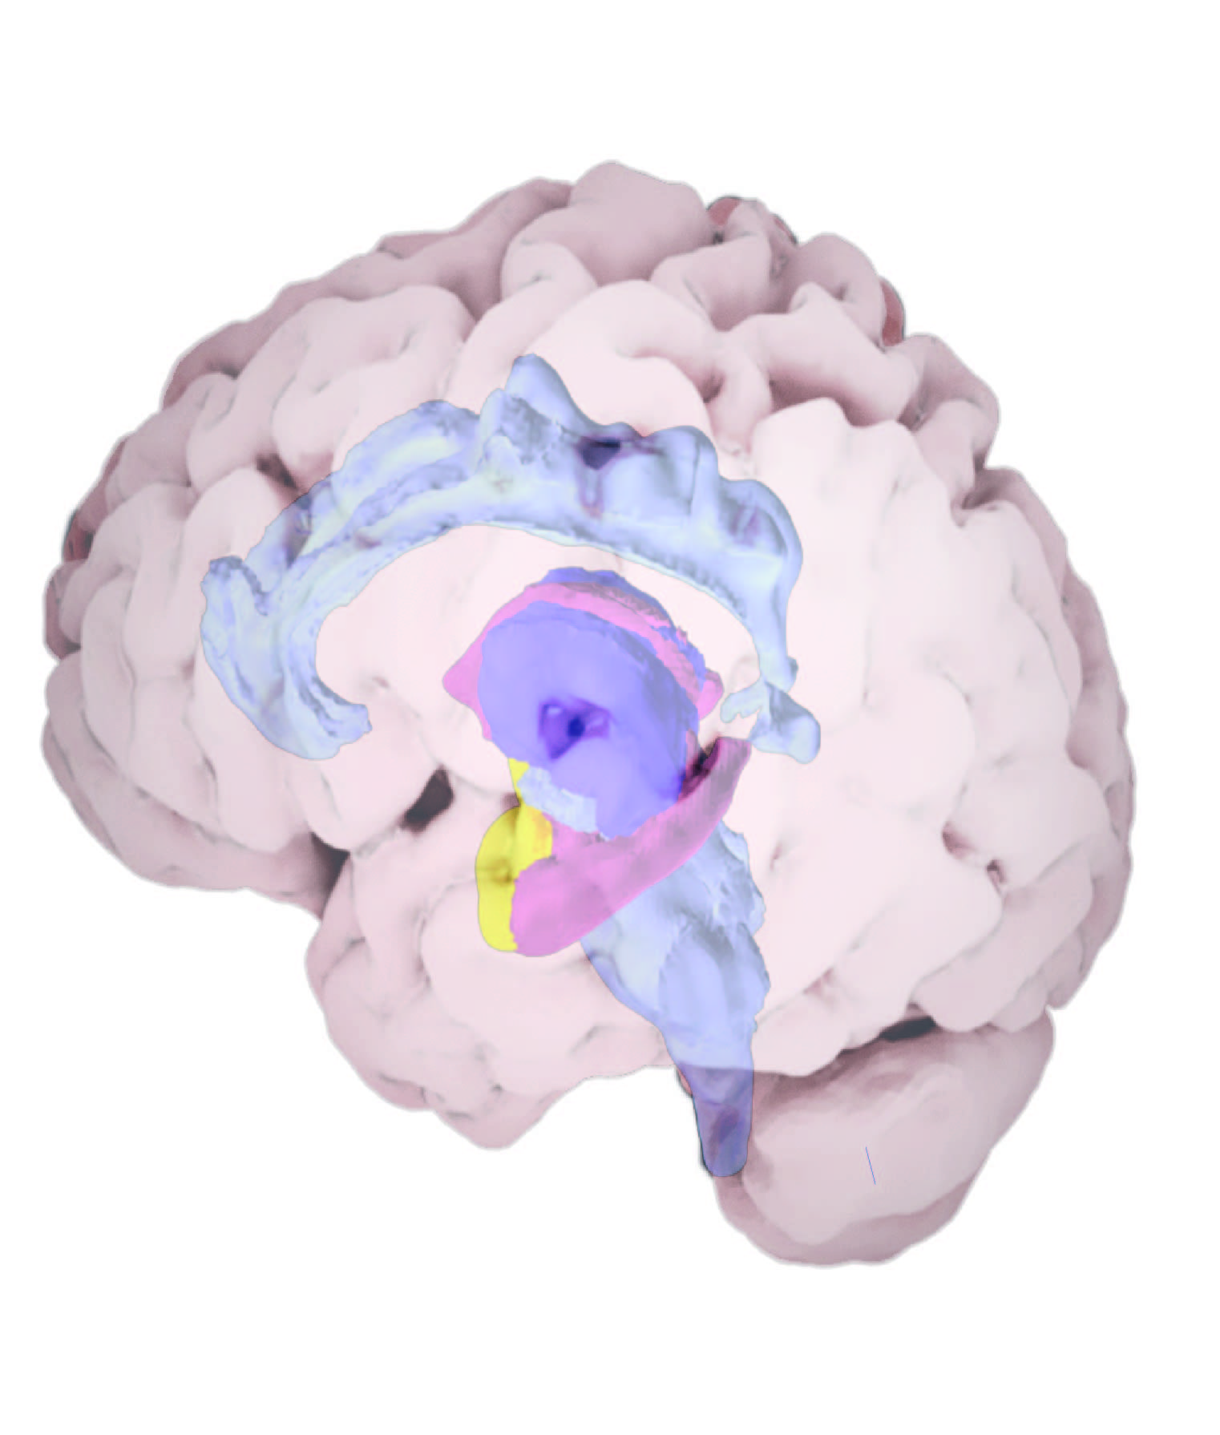
Temporal changes in FC
Traditionally, most FC studies assumed that FC is temporally stationary (seek FC over all time points)
Recent studies demonstrate time varying properties of FC
Analysis approaches
Sliding Window
2D ICA (Both space and time)
Variable parameter regression
Notes:
מרבית המחקרים מסתכלים על קישוריות כתכונה קבועה ולא בודקים השתנות בזמן
לאחרונה התפרסמו מספר עבודות אשר מראות שינויי קישוריות בזמן מנוחה אצל אותו פרט (בבני אדם ובבעלי חיים)

Slide 5
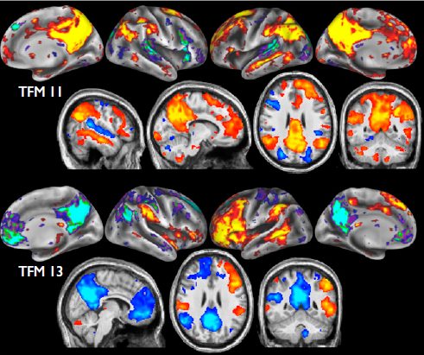
Temporally-independent functional modes (TFMs) Smith et. Al. 2012
2 dimensional group ICA
Step1: Spatial ICA – spatial components
Step 2: Temporal ICA is performed on the time courses extracted for the components detected in step 1
Step 3: Spatial maps are generated by Regressing the TFM time courses into the original datasets and averaging the resulting maps across all runs/subjects
Each TFM is discussed anatomically
Requires fMRI with 0.8 secs temporal resolution
Spatial maps for TFMs 11 (semantic with default mode system) and 13 (language versus default mode system).
Notes:
Spatial ICA yielded 200 components
58 were manually identified as artifacts
142 remained (relatively compact structure)
Temporal ICA over the 142 time courses yielded 21 components, according to which TFMs were defined.

Slide 6
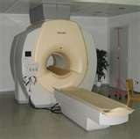
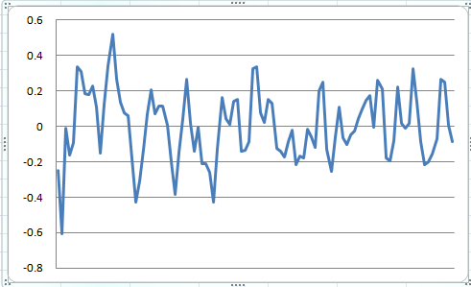
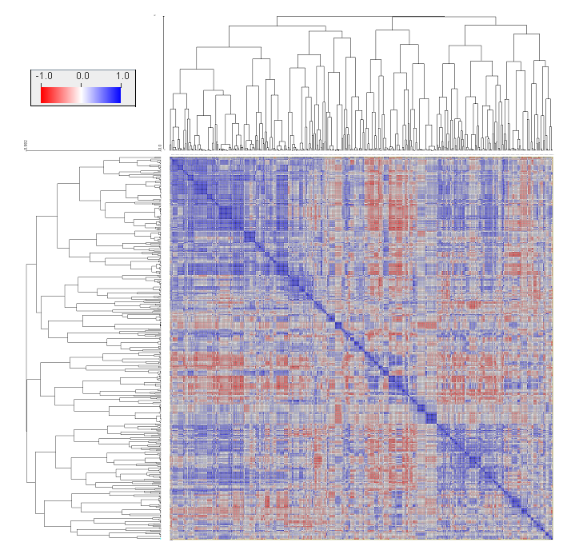
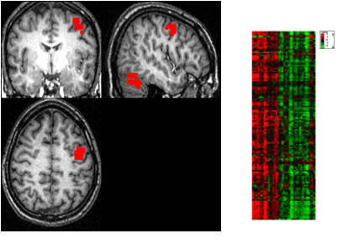
Our approach – Contiguous Biclustering (ConBic)
Seed detection in every time window
Find contagious voxel groups with predetermined length of time intervals and high signal similarity.
A contiguous bicluster (ConBic) One or more spatially contiguous groups of voxels exhibiting homogenous behavior across one or more sets of consecutive TRs.
Similarity based region clustering

Slide 7
ConBic stage 1 – region detection
Use a sliding time window (predefined length)
For each window select a set of seed voxels
From each voxel grow a homogenous region
Parameters:
Region growing correlation threshold
Max allowed region growth radius
Time window size
Time window shift

Slide 8
Current Input
fMRI data of ~5 min resting state
3mm volumes
Gray matter mask
2 secs time points
Parameters
0.8 region growing correlation threshold
max region radius = 5 voxels
Time window size = 20 TRs
Time window shift = 10 TRs
~ 60000 X 150

Slide 9
Seed selection
Requirements
“Interesting” i.e. candidates (variable enough or have at least n peaks in time window)
Well spread (represent the whole gray matter)
Approaches
Farthest point heuristic: randomly select one candidate voxel, iteratively add the candidate that is farthest from all previously selected seeds
Grid approach: use a 3D grid to partition the space into cells. Randomly select a predefined number of candidates from each cell

Slide 10
Stage 1 – some results
Data | Seed selection | #Regions | # voxels | Hom | Average overall hom | Reproducibility
 |  |  |  |  |  | Voxel | Entry
1004 | Grid (cell=5v³) | 7170 | 126±111 | 0.778±0.036 | 0.55±0.1 | 0.65± 0.24 | 0.622±0.28
1004 | Farthest | 3550 | 113±72 | 0.79±0.037 | 0.6±0.1 | 0.47± 0.2 | 0.38± 0.24
1005 | Grid (cell=5v³) | 8275 | 135±118 | 0.778±0.035 | 0.54±0.1 | 0.62± 0.24 | 0.59± 0.28
1005 | Farthest | 3785 | 115±78 | 0.79±0.035 | 0.58±0.1 | 0.46± 0.19 | 0.37± 0.23

Slide 11
Stage 1 – some results
Data | Seed selection | #Regions | # voxels | Hom | Average overall hom | Reproducibility
 |  |  |  |  |  | Voxel | Entry
1004 | Grid (cell=5v³) | 5671
1004 | Farthest | 3991 | 110±71 | 0.8±0.037 | 0.59±0.1 | 0.55± 0.24 | 0.47± 0.29
1005 | Grid (cell=5v³)
1005 | Farthest

Slide 12
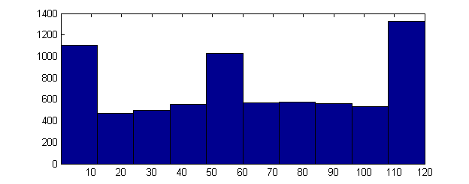
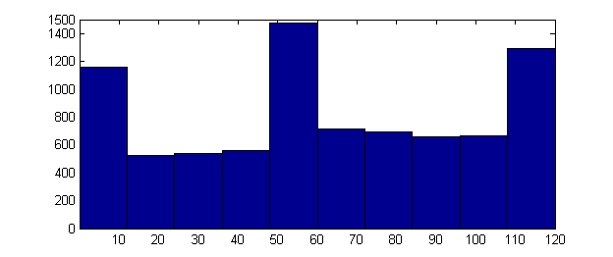
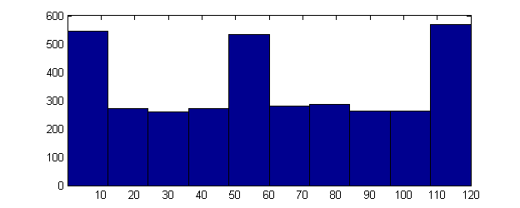
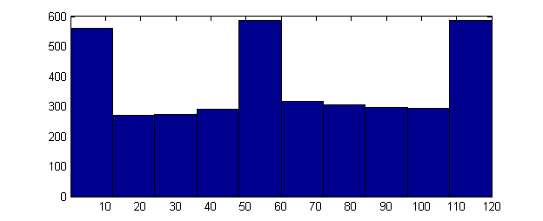
Region Sizes Vs. time window
Grid seed selection
Farthest point seed selection

Slide 13
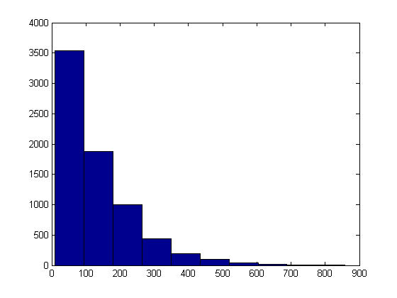
Voxel number distributions
Farthest point seed selection
Number of regions
Grid seed selection
Number of voxels
Number of regions
Number of voxels

Slide 14
Data Box Plot

Slide 15
Stage 2 – merging regions
Assumption1 : if a signal appears in multiple time windows it is less likely to be noise/artifact
Assumption2 : if a signal appears in multiple brain regions (but not whole brain) it is likely to represent inter-regional functional connectivity
Conclusion: we are interested in regions that can be spatially/temporally expanded and would still demonstrate high homogeneity
How can we merge regions? (Didi…)

Slide 16
Bic evaluation
Bic sizes (Voxel&TRs)
Homogeneity
Homogeneity over entire time frame
# Connected components
Anatomic labeling content
Bilateral symmetry
Reproducibility across runs
Reproducibility across subjects

Slide 17
fMRI results
Data | Seed selection | #Bics | # voxels | # TRs | Homogeneity | Overall hom | #Bics>2 CC
1004 | Farthest | 575 (3595) | 248±148 (113±72) | 44±13 | 0.732±0.04 (0.79±0.037) | 0.6±0.08 (0.6±0.1) | 232
1004 | Grid | 775 (7170) | 305±204 (126±111) | 41±12 | 0.727 ±0.04 (0.778±0.036) | 0 .57±0.08 (0.55±0.1) | 389
1005 | Farthest | 537 (3743) | 278±153 (115±78) | 43±12 | 0.733±0.042 (0.79±0.035) | 0.56±0.07 (0.58±0.1) | 255
1005 | Grid | 811 (8275) | 343±224 (135±118) | 40±11 | 0.73±0.038 (0.778±0.035) | 0.54±0.07 (0.54±0.1) | 438

Slide 18
ConBic sizes according to # connected components (grid seed selection)
Notes:
Single subject 1004

Slide 19
ConBic sizes according to # merged regions (grid seed selection)
Notes:
Single subject 1004

Slide 20
ConBic sizes according to # connected components (FP seed selection)
Notes:
Single subject 1004

Slide 21
ConBic sizes according to # merged regions (FP seed selection)
Notes:
Single subject 1004

Slide 22
Between run reproducibility
 | Best entry Jaccard FP seed selection | Best entry Jaccard grid seed selection | Stage2 best Jaccard
1004 run1_2 | 0.21±0.13 (20>=0.5) | 0.27±0.19 (87>=0.5)
1005 run1_2 | 0.196±0.124 (10>=0.5) | 0.26±0.18 (90>=0.5) | 0.76±0.35 (401>=0.5)

Slide 23
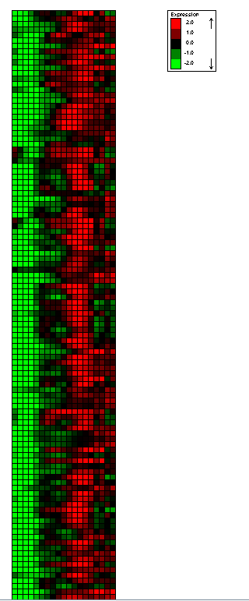
Bi-laterality examples
Data 1001
Bic 1698,44
Size:465 voxels * 20 TRs
Anatomic labeling: Hippocampus_L
Hippocampus_R
ParaHippocampal_L

Slide 24
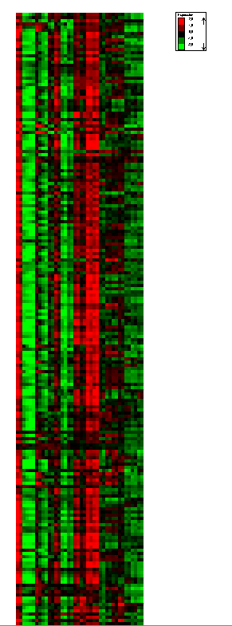
Bi-laterality examples
Data 1004
Bic 1352,1277,2847
323 voxels*40TRs
Anatomic labeling: Frontal_Inf_Tri_L
Frontal_Mid_L
Frontal_Mid_R

Slide 25
Bi-laterality examples
Data: 1004
Bic: 1052,5938,6840
Size: 558 voxels * 60 TRs
Anatomic labeling:
ORD Rolandic_Oper_R (11%)
T2G Temporal_Mid_L (12%)
T1G Temporal_Sup_L (17%)
T1D Temporal_Sup_R (37%)

Slide 26
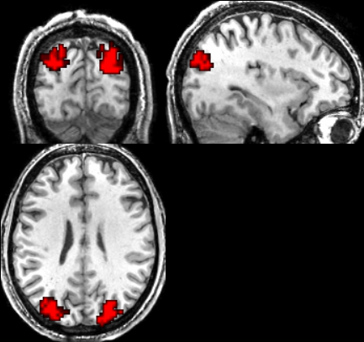
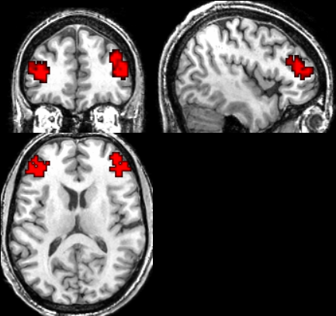
Two more…

Slide 27
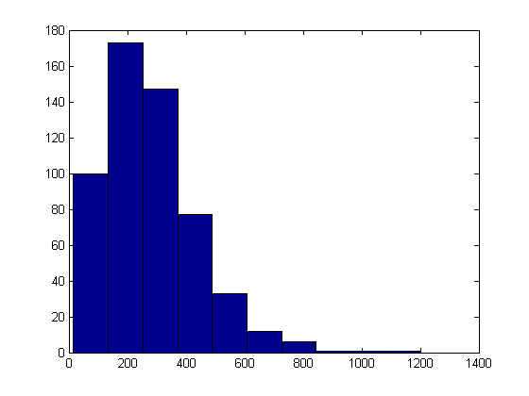
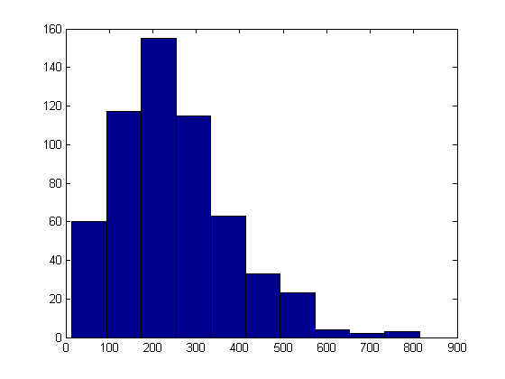
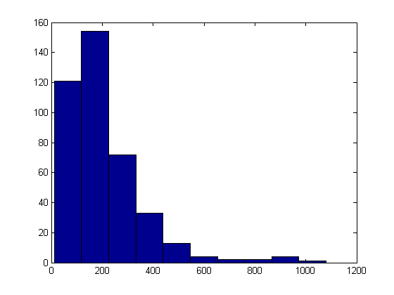
Voxel number distributions
1005 run 1
1005 run 2
1005 run 2
1004 run 1
1001 run 2

Slide 28
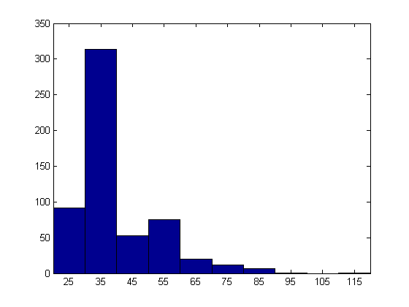
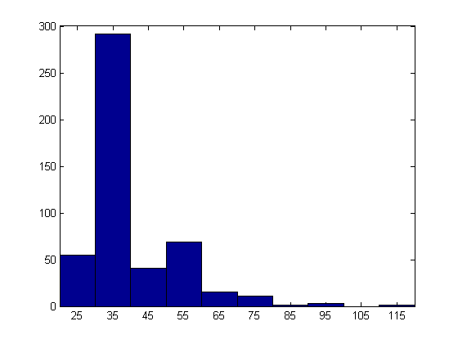
TR number distribution
1004 run 1
1004 run 2
1005 run 1

Slide 29
Between run reproducibility
 | Voxel Best Jac | Entry best jac | Stage2 Voxel Best jac | Stage2 entry best jac
1001 run1 | 0.327±0.16
1001 run2 | 0.319±0.16
1004 run1 | 0.38±0.16
1004 run2 | 0.4±0.16 (146>=0.5)
1005 run1 | 0.35±0.154 (95>=0.5) | 0.196±0.124 (10>=0.5) | 0.8±0.29 (425>=0.5)
1005 run2 | 0.35±0.157 (101>=0.5) | 0.193±0.122 (10>=0.5) | 0.82±0.276 (445>=0.5) | 0.76±0.35 (401>=0.5)

